Slide 1
CIS117 Week 13
Alias, history and prompts

Slide 2
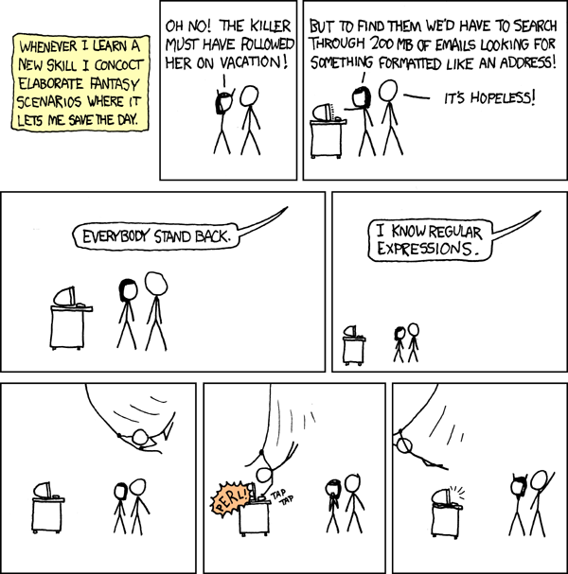
Alias
Shortcut or synonym for frequently used commands
Easy way to use complex command structures (lots of switches, pipes etc.)
To create an alias 'alias' to delete 'unalias'
To make permanent add alias to .bashrc
DANGER HERE easy to mess up the .bashrc file use caution
https://xkcd.com/208/

Slide 3
Hidden bash files
Use the switch –a to see them, ls –a shows hidden files
.bash_profile
Runs on log in
Used to set paths
Changes you want to happen at log in
.bash-history
Records all commands used

Slide 4
Prompts
User prompt is environmental variable
Show: echo $PS1
Change: PS1=newprompt
Permanent change by changing .bash_profile
DANGER!! Can mess yourself up very easily and very badly

Slide 5
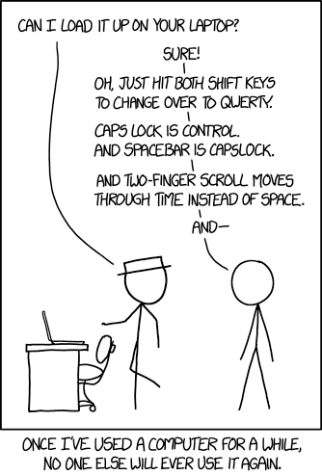
Potentially useful prompts
Show last command run
Change color if last command run was successful
Show working directory
Show directory info
https://www.explainxkcd.com/wiki/index.php/1806:_Borrow_Your_Laptop

